Slide 1


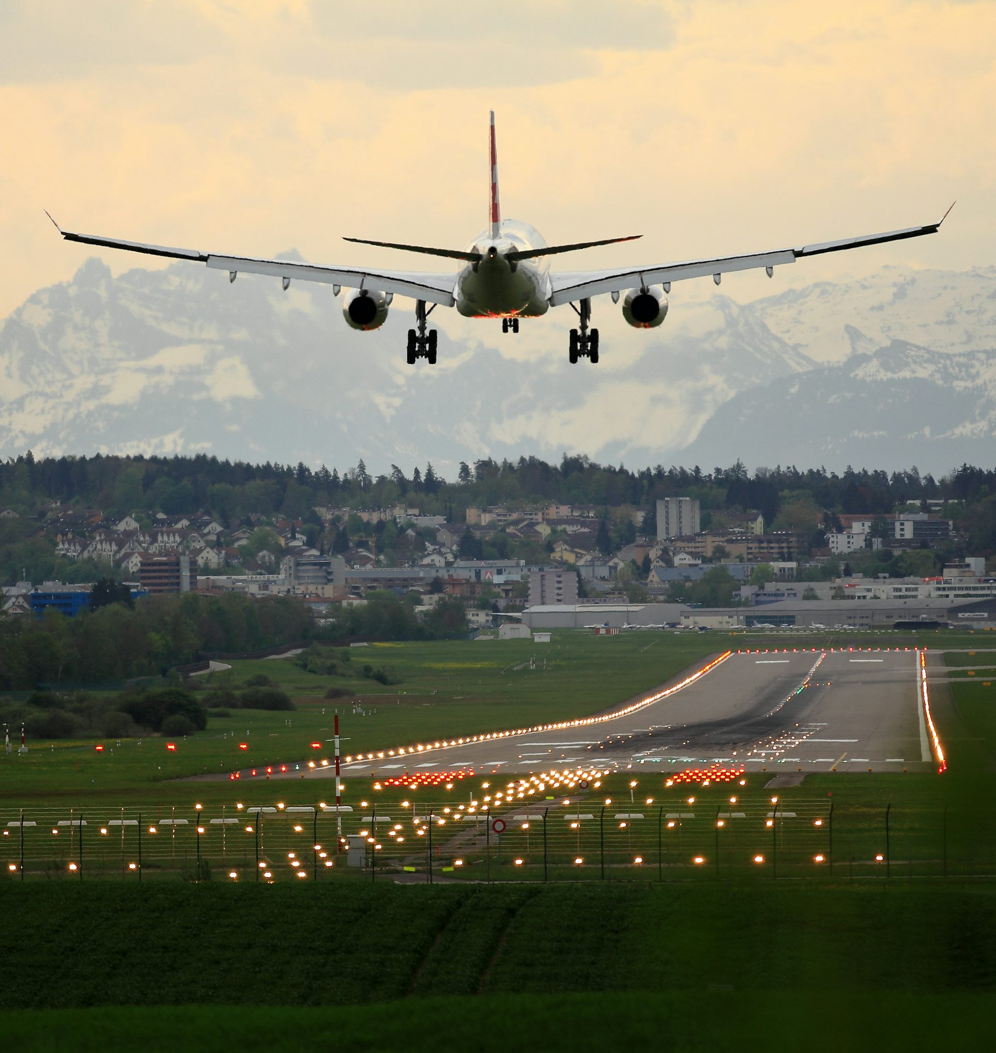
Data Visualization
U.S. Federal Aviation Administration Flight Analysis (Cancelations & Delays)
October 5, 2025
Rawad Yared
All graphs and visuals were prepared on PowerBI which can be found on the dashboard and interactively adjusted

Slide 2

Project Context?
FAA: The Federal Aviation Administration (FAA) oversees the safety and efficiency of over 1.9 million flights each year across the United States.
In recent years, growing delays and cancellations have raised public frustration, disrupted airline operations, and increased regulatory pressure. FAA leaders needed a clear, data-driven view of the underlying trends and causes to guide targeted interventions.

Slide 3

Key Analysis Questions
1
Where and when are delays and cancellations most severe?
2
Which airlines and external factors are driving them?
3
How much are delays and cancellations costing?
4
How can the FAA focus its limited resources to achieve the greatest impact on on-time performance?

Slide 4
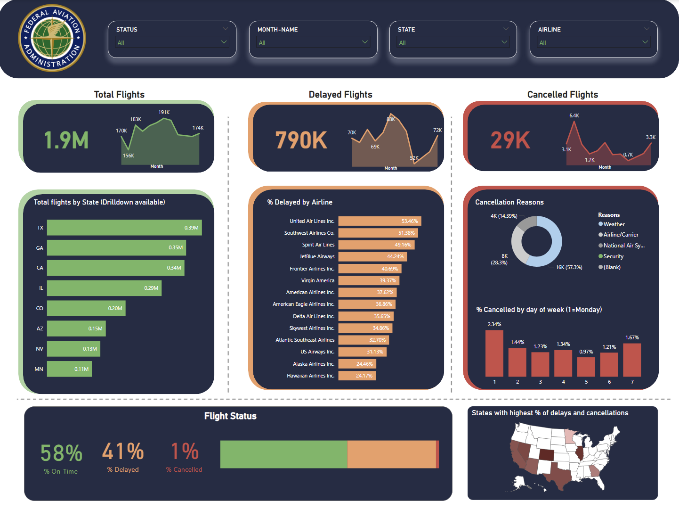
The initial view gives some insights however after further analysis and a deeper look, new findings appear that can help the FAA structure a plan
Key findings
Overall Performance: The FAA managed around 1.9M flights with only 58% on time, while 41% experienced delays and 1% were cancelled (major challenge)
Delay Concentration by Airline: At first we can see that 5 airlines have delay percentage above 40% including United (53%) and Southwest (51%) which indicates little reliability in those airlines, however after a deeper look into the value-based analysis we notice that in absolute terms FAA can focus on Delta (0.23M), Skywest (0.14M), United (0.14M) and Southwest (0.14M). This would cover 650K out of the 790K which are a majority
Geographic Hotspots: Texas, Georgia, California, and Illinois account for the largest flight volumes. In the heatmap of states we can see that Colorado comes out on top when taking into consideration cancellations
Cancellation Drivers: Most cancellations are linked to airline/carrier operational issues (57%), followed by weather (28%). Weather can’t be controlled however operational improvement in airline/carrier issues give the best results
Seasonal Patterns: Cancellations peak on Sundays and Mondays and drop mid-week, which is hinting that it could be a demand-related issue as business travelers would fly on these days
Key Insights

Slide 5
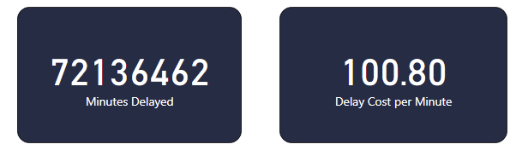

Considerations & Next Steps
Considerations
Economic Impact: Flight delays amounted to over 72 million minutes, with an estimated cost of $7.2 billion annually. This number can be significantly reduced by focusing on key areas
Focus Areas Identified: A targeted effort on the top few airlines (Delta, United, Southwest, SkyWest) and high-volume states (e.g., TX, GA, CA, IL) can address the bulk of delays and cancellations
Operational vs. Uncontrollable Factors: While weather accounts for about 28% of cancellations, the majority (57%) stem from airline/carrier operational issues—indicating a clear opportunity for improvement
Next Steps
Prioritize Data-Driven Interventions: Use the dashboard to continuously monitor hotspots—by state, airline, and season—to guide resource allocation and compliance actions
Collaborate with Carriers: Launch joint operational-efficiency programs with top delaying airlines to reduce turnaround bottlenecks and staffing gaps
Target Seasonal Patterns: Focus on peak problem periods—particularly early-week cancellations (Sundays/Mondays)
Source of cost of delay: https://www.airlines.org/dataset/u-s-passenger-carrier-delay-costs/

Slide 6
Thank You

Slide 7
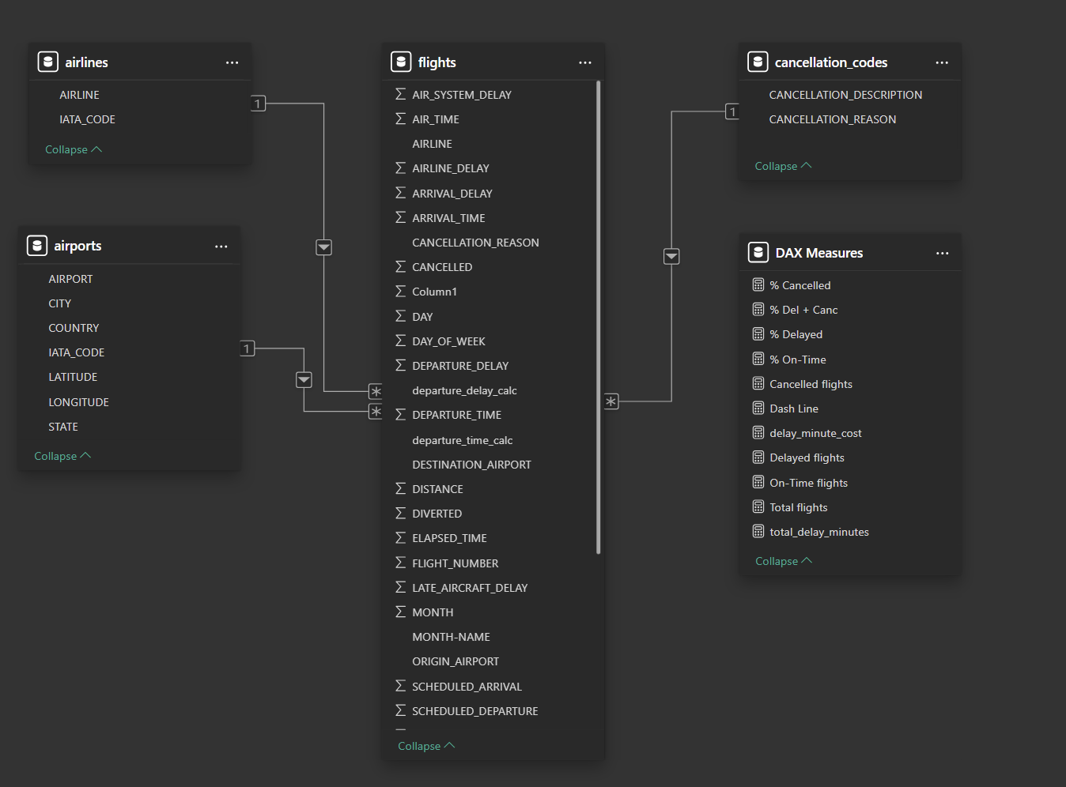
Data Model Explanation
Data Model
Central Fact Table – flights: Contains detailed flight-level records, including times, delays, cancellations, origins and destinations. This is the main dataset used for the majority of visualizations and calculations
Lookup Tables – airlines & airports: airlines links each flight’s airline code to its full name while airports links origin and destination airport codes to location details (state, country, latitude/longitude).
Reference Table – cancellation_codes: Maps each flight’s cancellation reason to a readable description (e.g., Weather, Carrier, Security). This enables us to group and visualize cancellation reasons.
DAX Measures Table: Stores all calculated metrics such as
Total Flights
% On-Time, % Delayed, % Cancelled
Total Delay Minutes and Delay-Minute Cost
This keeps KPIs centralized and consistent across visuals
Relationships are built like a star schema: flights (fact table) connects to each dimension table using common keys:
AIRLINE column to airlines table
ORIGIN_AIRPORT / DESTINATION_AIRPORT columns to airports table
CANCELLATION_REASON column to cancellation_codes table
These relationships allow filtering and drill-downs by airline, airport, location, or cancellation reason.
Explanation

